Slide 1

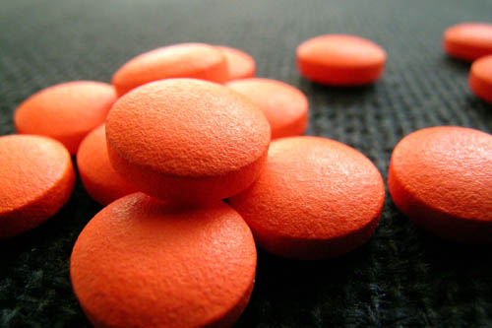
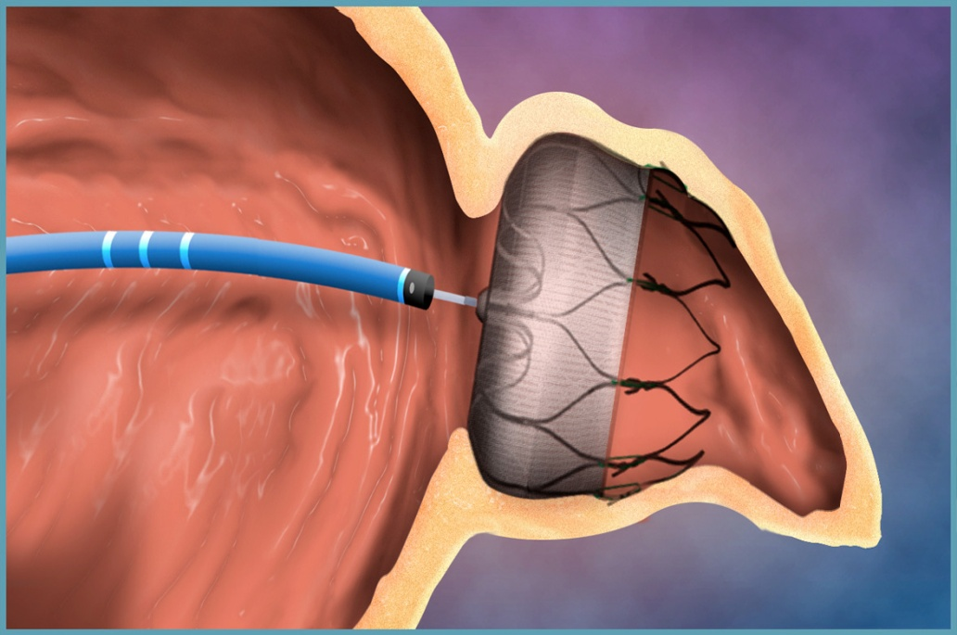

Institut Cardiovasculaire Paris Sud
Anticoagulation de la FA :
Situations particulières
AFLB 2012
Dr. Jérôme Lacotte
UNITÉ DE RYTHMOLOGIE, ICPS, MASSY
Notes:
15h00-16h30 Anticoagulation de la Fibrillation auriculaire
- Qui anticoaguler? Samer Nasr
- Surveillance biologique des nouveaux anticoagulants Jacqueline Conard
- Situations particulières Jérôme Lacotte
- Dabigatran: recommandations et usage pratique Georges Ghanem

Slide 2
1. la FA isolée existe-t-elle (encore) ?

Slide 3
Homme, 69 ans
Pas d’antécédents, HTA et FA chez le père
ECG et Echo TT normale
FA paroxystique, quelques heures tous les mois
Asymptomatique, Holter normal sous Flécaine
Notes:
CHADS vs CHADS vasc : plus beaucoup de scores 0 ou 1
Faut il anticoaguler les scores 1 ? Quel est le risque ?
Parox ou persistante : idem ?

Slide 4
A votre avis :
Quel risque embolique annuel ?
Paroxystique moins à risque que persistant ?
AVK, Aspirine, rien… jusqu’à quand ?

Slide 5
Score CHADS₂
CHA₂DS₂VASc
Diabète
AVC
Insuffisance cardiaque
Hypertension artérielle
Age > 75 ans
Diabète
AVC
Insuffisance cardiaque
Hypertension artérielle
SCA, Plaques Ao, AOMI
Age > 75 ans
Age > 65 ans
Sexe féminin
Guidelines FA ESC 2010

Slide 6
AVC / an (%)
Patients (n)
CHADS₂
66%
CHA₂DS₂VASc
1 à 2%
94%
Guidelines FA ESC 2010

Slide 7
A votre avis :
Quel risque embolique annuel ?
Paroxystique moins à risque que persistant ?
AVK, Aspirine, rien… jusqu’à quand ?

Slide 8
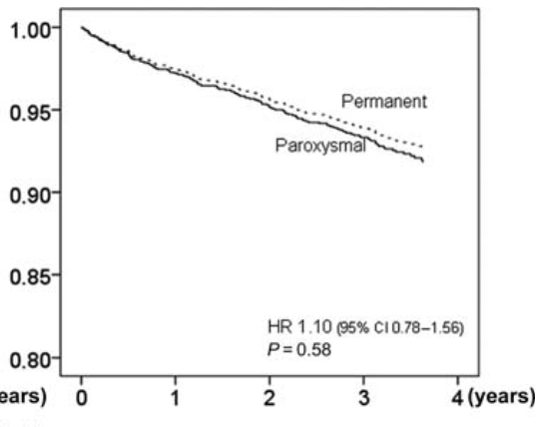
FA (parox ou persist) = AVC * 2
Parox avec AVK vs sans AVK = AVC / 2
Friberg, EJH 2010;31(8):967-75
Notes:
Hopital Stockholm 2002, 1981 patients vus en consult pour FA ou flutter
Incidence annuelle AVC
Population différente en age et comorbidités

Slide 9
A votre avis :
Quel risque embolique annuel ?
Paroxystique moins à risque que persistant ?
AVK, Aspirine, rien… jusqu’à quand ?

Slide 10
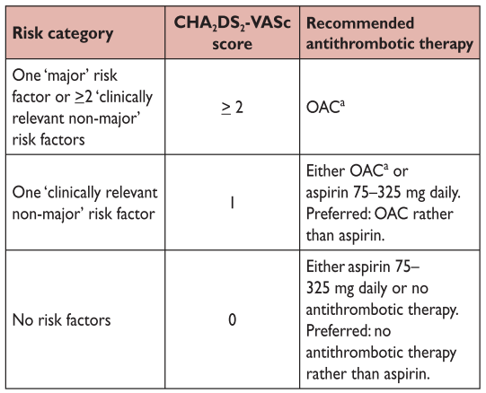
Guidelines FA ESC 2010

Slide 11
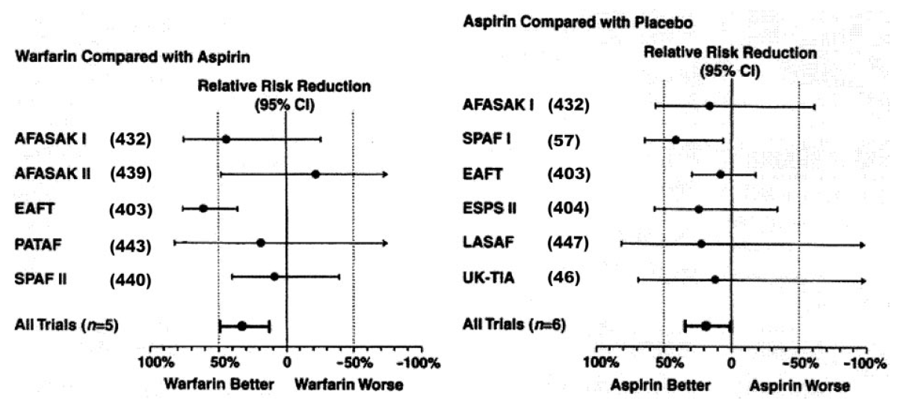
L’aspirine protège peu ou pas contre l’AVC
AVK >> AAP
AAP # Placebo
Circulation 2006;114:e257

Slide 12
A votre avis :
Quel risque embolique annuel ?
Paroxystique moins à risque que persistant ?
AVK, Aspirine, rien… jusqu’à quand ?
Et Aspirine + Clopidogrel ?

Slide 13
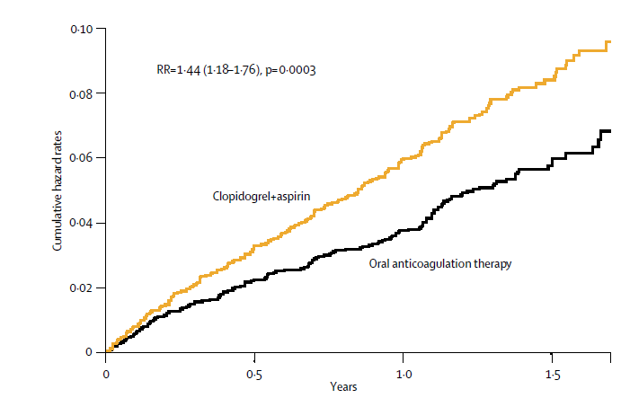
Active W : Warfarine vs ASA + Clopi
6706 patients
Embolies dont AVC
SCA
Mortalité CV
ACTIVE investigators, Lancet 2006

Slide 14
2. Le coronarien fibrillant
(un quart des FA)

Slide 15
Homme, 79 ans
HTA
FA persistante, peu symptomatique
AVK difficile à stabiliser, jamais d’hémorragie
SCA ST - apical : ATL IVA moy. avec DE Stent
Notes:
CHADS vs CHADS vasc : plus beaucoup de scores 0 ou 1
Faut il anticoaguler les scores 1 ? Quel est le risque ?
Parox ou persistante : idem ?

Slide 16
A votre avis :
AVK + clopidogrel + aspirine
Dabigatran + clopidogrel + aspirine
AVK + clopidogrel
A vie ?

Slide 17
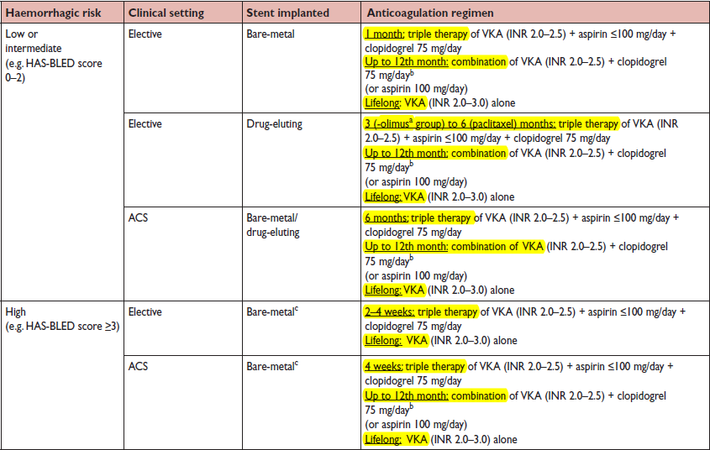
Guidelines FA ESC 2010
Notes:
According to the most recent European Society of Cardiology guidelines for the treatment of NSTE acute coronary syndrome (33), the more effective P2Y12 inhibi- tors prasugrel and ticagrelor are now the preferred antiplate- let agents in combination with aspirin. In the joint Amer- ican College of Cardiology Foundation/American Heart Association/Society for Cardiovascular Angiography and Interventions Guideline for Percutaneous Coronary Inter- ventions, prasugrel and ticagrelor are considered at the same level as clopidogrel for percutaneous coronary intervention treatment in acute coronary syndromes (Class

Slide 18
HAS-BLED
Hémo % an
Population
Saignement
INR labile
Hypertension
Anomalie Hép.Rénale
AVC
Age > 75 ans
Alcool ou TTT interagissant
8%
Guidelines FA ESC 2010

Slide 19
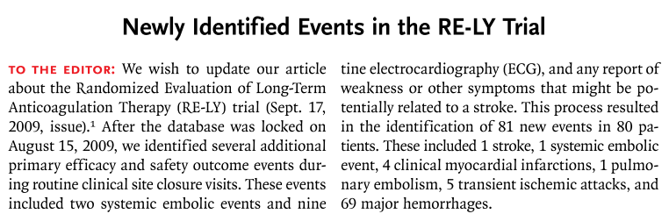
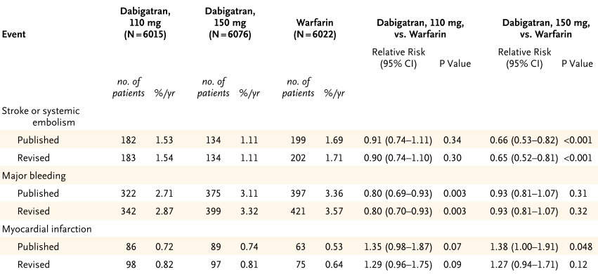
Connolly, NEJM2010 Nov;363(19):1875-6
Notes:
According to the most recent European Society of Cardiology guidelines for the treatment of NSTE acute coronary syndrome (33), the more effective P2Y12 inhibi- tors prasugrel and ticagrelor are now the preferred antiplate- let agents in combination with aspirin. In the joint Amer- ican College of Cardiology Foundation/American Heart Association/Society for Cardiovascular Angiography and Interventions Guideline for Percutaneous Coronary Inter- ventions, prasugrel and ticagrelor are considered at the same level as clopidogrel for percutaneous coronary intervention treatment in acute coronary syndromes (Class

Slide 20
3. Le fibrillant saignant sous AVK

Slide 21
Homme, 58 ans
FA persistante
ChadsVasc 3 (HTA, diabète, CMH)
Hémorragie méningée sous AVK, sans surdosage ni malformation vasculaire
Notes:
CHADS vs CHADS vasc : plus beaucoup de scores 0 ou 1
Faut il anticoaguler les scores 1 ? Quel est le risque ?
Parox ou persistante : idem ?

Slide 22
A votre avis :
Aucun anti-thrombotique
Aspirine
AVK avec INR hebdomadaire
Dabigatran 110 mg * 2
Autre solution ?

Slide 23
RE-LY : suivi moyen de 2 ans
*
*
*
*
*
* p<0.05
Connolly, N Engl J Med 2009;361:1139-51

Slide 24
A votre avis :
Aucun anti-thrombotique
Aspirine
AVK avec INR hebdomadaire
Dabigatran 110 mg * 2
Autre solution ?

Slide 25
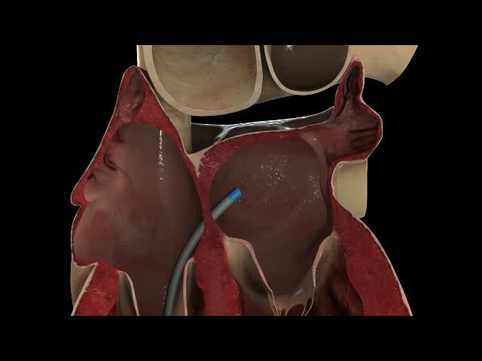

Slide 26
Prothèse vs AVK : PROTECT AF
Randomisation 2 prothèses / 1 AVK
Etude de non infériorité
FA avec CHADS₂ ≥ 1
Exclusion : CI° AVK, PFO, thrombus OG
Holmes, Lancet 2009; 374: 534–42

Slide 27
 | Prothèse n=463 | Contrôle n=244
Age | 71·7 (8·8; 46·0–95·0) | 72·7 (9·2; 41·0–95·0)
CHADS 1 2 3 4 5 6 | 157 (33·9%) 158 (34·1%) 88 (19·0%) 37 (8·0%) 19 (4·1%) 4 (0·9%) | 66 (27·0%) 88 (36·1%) 51 (20·9%) 24 (9·8%) 10 (4·1%) 5 (2·0%)
Déjà sous AVK | 254 (54·9%) | 145 (59·4%)
FEVG | 57·3% (9·7; 30·0–82·0) | 56·7% (10·1; 30·0–86·0)
AIT / AVC | 82 (17·7%) | 49 (20·1%)
Holmes, Lancet 2009; 374: 534–42

Slide 28
Post-
Implant
Day 0
Day 45
Day 180
Ongoing
Day 2-14
Pre-implant interval
Patient gets WATCHMAN
WATCHMAN
Patient takes Warfarin
Patient discontinues Warfarin / takes Clopidogrel
Patient discontinues Clopidogrel
Randomize 2/1
Control
Control patient takes Warfarin
4998 patients candidats
4191 non inclus (CEE, ablation, anatomie, refus patient, AVK non recevables…)
707 randomisés dont 463 pour prothèse
449 implantations tentées
408 implantations réussies (91%)
Holmes, Lancet 2009; 374: 534–42
Notes:
45 jours d’AVK
ETO à J45, M6, M12

Slide 29
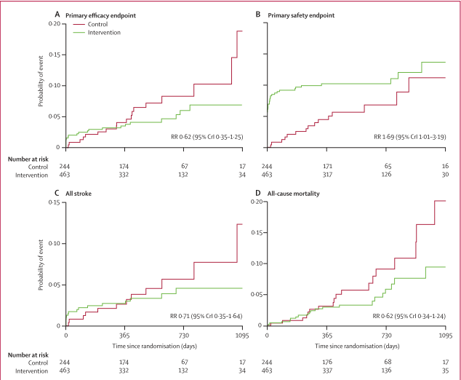

Hémorragies
Ep. Péric, Embolie proth
AVC hem / isch
Décès CV / MS
Embolie Syst
Ep. Péricardique : 4.8%
Plus d’AVK à 6 mois : 92%
Notes:
Suivi moyen 18 mois

Slide 30
4. Le fibrillant ablaté

Slide 31
Homme, 57 ans
FA permanente, très symptomatique, dysfonction VG rythmique
ChadsVasc 3 (HTA, diabétique, FEVG altérée)
Ablation FA il y a 3 mois :
  Plus de palpitations
  Holter à 1 et 3 mois : rares ESA isolées
  Normalisation FEVG
  Sous Flécaine - AVK
Notes:
CHADS vs CHADS vasc : plus beaucoup de scores 0 ou 1
Faut il anticoaguler les scores 1 ? Quel est le risque ?
Parox ou persistante : idem ?

Slide 32
A votre avis :
Stop AVK
Stop AVK, relai par aspirine
Maintien AVK, surveillance Holter
AVK à vie, même si rythme sinusal

Slide 33
AVK post ablation
Aucune démonstration que l’ablation réduit le risque d’AVC
Donc, toujours 1 ou 2 mois d’AVK
Voire plus (a vie) si Chads ≥ 1 ou 2
2012 HRS/EHRA/ECAS Expert Consensus, Europace 2012

Slide 34
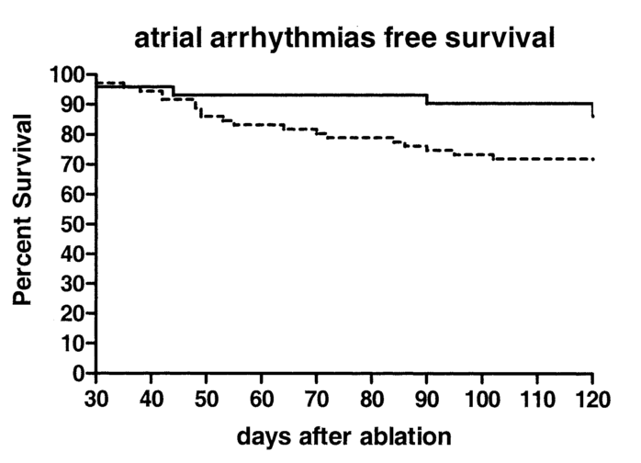
Car récidives asymptomatiques
Holter à 1 et 4 mois
Télé ECG / jr
50% des épisodes de FA
sont asymptomatiques
Senatore, JACC 2005:873-6
Notes:
OBJECTIVES
The aim of our study was to determine the incidence of asymptomatic recurrences of atrial fibrillation (AF) by daily transtelephonic (TT) electrocardiographic (ECG) monitoring, as compared with standard ECG and 24-h Holter recording, in patients who underwent radiofrequency catheter ablation (RCA) of AF.
BACKGROUND The efficacy of RCA of AF is usually evaluated by means of patients’ symptoms. METHODS
Seventy-two patients with paroxysmal (n  37) or persistent (n  35) drug-refractory AF underwent circumferential RCA of the pulmonary vein (PV) ostia. Left isthmus ablation was performed in 57 patients, and cavotricuspid isthmus ablation was done in 69 patients. Patients were scheduled to obtain an ECG and Holter recordings one and four months after ablation, as well as a daily TT ECG, from 30 to 120 days after ablation or in the event of symptoms.
RESULTS
A total of 5,585 TT ECGs were obtained (mean 77.5 per patient). In 20 patients (27.8%), AF recurrences were recorded during TT ECG, whereas ECG and Holter monitoring revealed AF recurrences in 10 patients (13.9%, p  0.001). Ten patients had at least one asymptomatic AF recurrence, and eight were completely asymptomatic. The ECG recorded in the event of symptoms always showed AF.
CONCLUSIONS Transtelephonic ECG is better than standard ECG and 24-h Holter recordings in evaluating AF relapses after RCA, thus decreasing the short-term success of ablation from 86% to 72%. The absence of symptoms should not be interpreted as absence of AF, as 50% of patients were asymptomatic during at least one AF episode. (J Am Coll Cardiol 2005;45:873–6) © 2005 by the American College of Cardiology Foundation

Slide 35
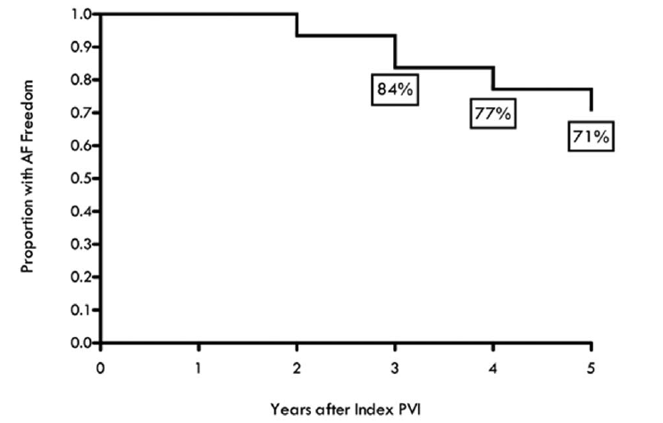
Car guérison pas toujours définitive
Pas de FA pendant l’année suivant l’ablation
Récidives tardives : 7% / an
Surtout si : FA persistante,
Age > 75 , HTA, dilat OG
Tzou, Circ AE 2010;3:237-242
Notes:
BACKGROUND: Pulmonary vein isolation (PVI) is increasingly used for treatment of atrial fibrillation (AF), but few reports exist regarding long-term success. We determined 5-year outcomes of PVI among patients with freedom from AF off antiarrhythmic drugs (AAD) for 1 year after PVI.
METHODS AND RESULTS: Consecutive patients with paroxysmal or persistent AF who underwent PVI at the University of Pennsylvania from 2000 to 2003 and were free from AF 1 year after ablation were included. Proximal isolation of PVs and non-PV triggers of AF was performed. Long-term ablation success, defined as freedom from AF off AAD after a single ablation procedure, was determined. All patients had transtelephonic monitoring at 3 to 6 months and 12 months and at least yearly contact thereafter. One hundred twenty-three patients were free of AF without AAD at 1 year. AF freedom off AAD was 85% at 3 years and 71% at 5 years, with an approximate 7% per year late recurrence rate after the first year. Patients with recurrent AF >or=5 years after index PVI were older, had larger left atrial size, more AF triggers and more likely had persistent AF. In multivariate analysis, persistent AF (odds ratio, 2.8; 95% confidence interval, 1.4 to 5.7, P=0.005) and age (odds ratio, 1.1; 95% confidence interval, 1.0 to 1.1, P=0.036) independently predicted long-term AF recurrence.
CONCLUSIONS: Among patients with paroxysmal or persistent AF and AF freedom 1 year after segmental PVI, the majority (71%) remained free of AF for up to 5 years, with an approximate late recurrence rate of 7% per year. Continued vigilance for recurrent AF after PV isolation is warranted, particularly in patients with persistent AF.

Slide 36
Conclusions
Le seul bénéfice pronostique démontré dans la FA concerne la prévention de l’AVC
Les solutions se diversifient : nouveaux AC, fermeture auricule
Stratifier les risques, tenir compte des comorbidités, individualiser les décisions
Encore beaucoup à comprendre et à démontrer

