Slide 1
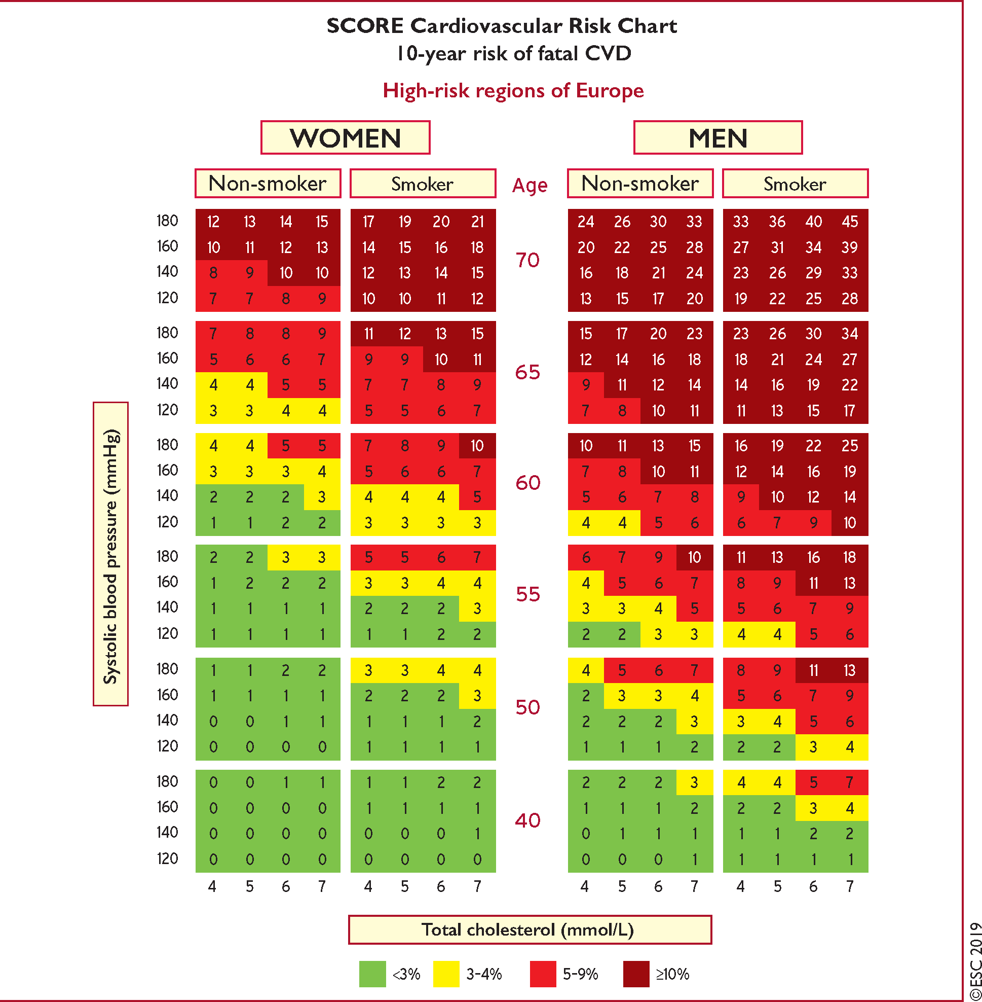
Figure 1 Systematic Coronary Risk Estimation chart for European populations at high cardiovascular disease risk. The ...
Notes:
Figure 1 Systematic Coronary Risk Estimation chart for European populations at high cardiovascular disease risk. The 10-year risk of fatal cardiovascular disease in populations at high cardiovascular disease risk based on the following risk factors: age, gender, smoking, systolic blood pressure, and total cholesterol. To convert the risk of fatal cardiovascular disease to risk of total (fatal + non-fatal) cardiovascular disease, multiply by 3 in men and by 4 in women, and slightly less in older people. Note: the Systematic Coronary Risk Estimation chart is for use in people without overt cardiovascular disease, diabetes (type 1 and 2), chronic kidney disease, familial hypercholesterolaemia, or very high levels of individual risk factors because such people are already at high-risk and need intensive risk factor management. Cholesterol: 1 mmol/L = 38.67 mg/dL. The SCORE risk charts presented above differ slightly from those in the 2016 European Society of Cardiology/European Atherosclerosis Society Guidelines for the management of dyslipidaemias and the 2016 European Guidelines on cardiovascular disease prevention in clinical practice, in that: (i) age has been extended from age 65 to 70; (ii) the interaction between age and each of the other risk factors has been incorporated, thus reducing the overestimation of risk in older persons in the original Systematic Coronary Risk Estimation charts; and (iii) the cholesterol band of 8 mmol/L has been removed, since such persons will qualify for further evaluation in any event. SCORE = Systematic Coronary Risk Estimation.
Unless provided in the caption above, the following copyright applies to the content of this slide: © The European Society of Cardiology and the European Atherosclerosis Association 2019. All rights reserved. For permissions please email: journals.permissions@oup.com.This article is published and distributed under the terms of the Oxford University Press, Standard Journals Publication Model (https://academic.oup.com/journals/pages/open_access/funder_policies/chorus/standard_publication_model)

